Slide 1
Interactive Kea Game
Anne Meyer, Jake Sebald, Joe Leanza, and Zach Allison

Slide 2
About Us and Main Division of Work
Computer Science:
Anne Meyer: meyer3ay@mail.uc.edu
Software/Programming
Project Management
Jake Sebald: sebaldjm@mail.uc.edu
Software/Programming
Data Collection
Computer Engineering:
Joe Leanza: leanzaja@mail.uc.edu
Hardware
Reward System
Electrical Engineering:
Zach Allison: allisozk@mail.uc.edu
Hardware
Installation/Train Kea
Project Advisor:
Dieter Vanderelst: vanderdt@ucmail.uc.edu
Cincinnati Zoo Contact:
Kathryn Kalafut: kkalafut@gmail.com

Slide 3
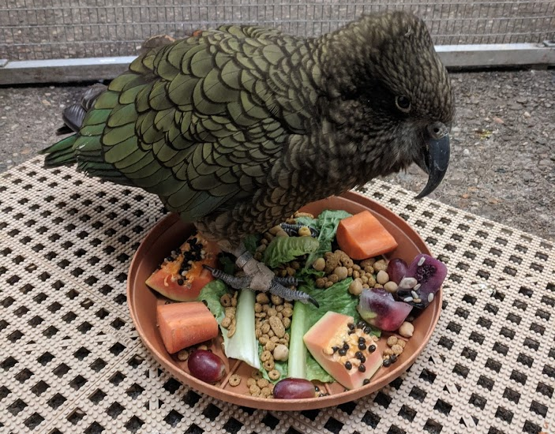
About Our Project
Kea
Intelligent birds
Native to New Zealand
Purpose:
Provide research data
Interactive game for Kea and guests
Goal:
Design and build a game that the Kea can learn to participate in with the Zoo guests
Capture data about the Kea

Slide 4
Intellectual Merits
Our greatest intellectual merits will be any research discoveries made through interactions with the Kea. This could include anything from the social nature of the birds, their ability to see screens and color, and to their ability to think critically in real time applications.

Slide 5
Project Impacts
The Interactive Kea project intends to create a system that allows the Cincinnati zoo guests to interact with the Kea birds by playing a game together. The Kea are intelligent birds capable of continuously learning new activities. The project will reward the Kea for their efforts while simultaneously collecting data for research. The data gathered will allow the Cincinnati Zookeepers to learn potentially new things regarding the Kea. The system will need to be safe to interact with for both the guests of all ages and for the Kea. The system itself will consist of one monitor for the guests and one for the birds, allowing them to interact at the same time.

Slide 6
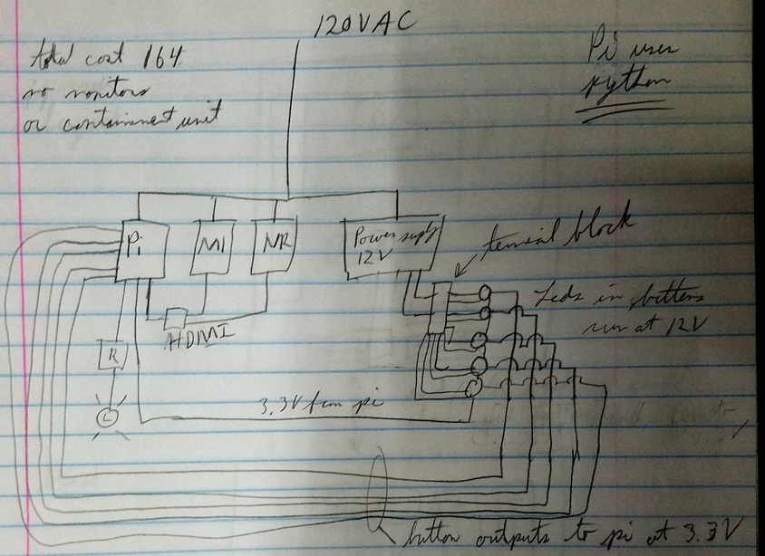
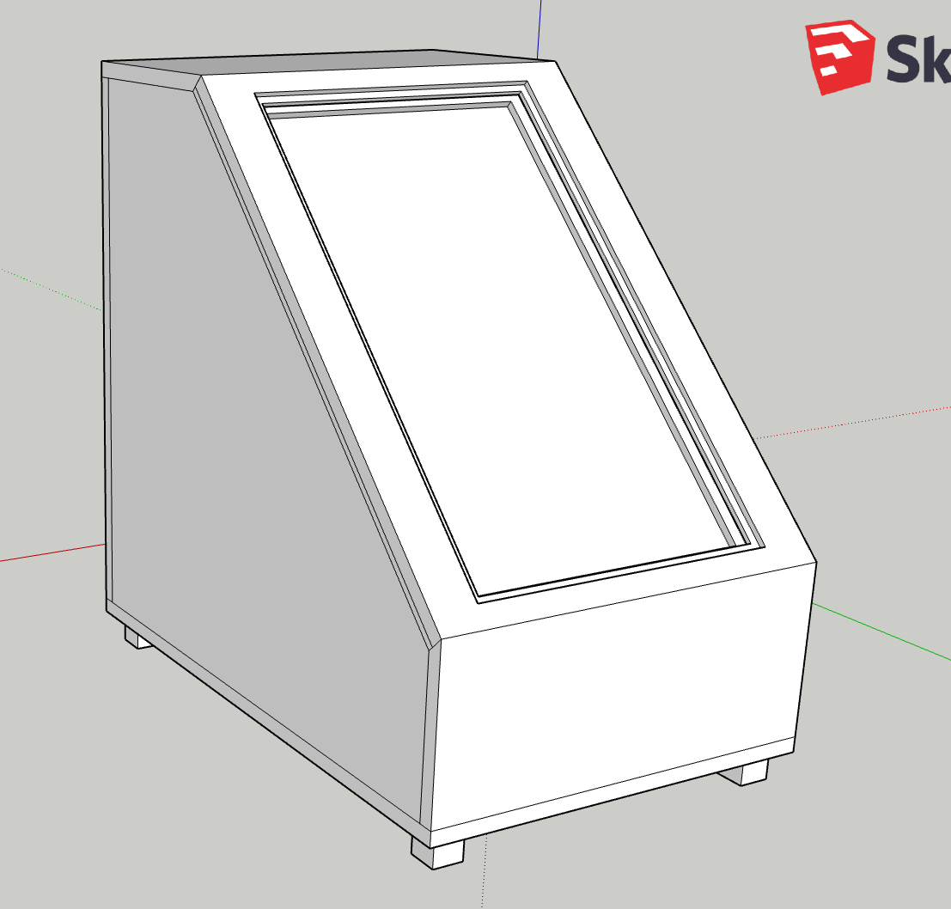
Design Specifications
Electrical Schematic
3D Model

Slide 7
Technologies
Raspberry Pi
Python
Pygame Pong - https://gist.github.com/vinothpandian/4337527
CAD Modeling Software
Winscp
Github
Momentary push buttons

Slide 8
Milestones
11/5 – Begin Hardware Design and Software Development
11/19 – Complete Hardware Purchase
11/26 -Build Hardware Prototype
1/21 - Testing Hardware and Software Together
2/15 – Build a Case and Stand
3/4 - Install Game at Zoo, Train the Kea
3/5 - Create Demo and Presentation

Slide 9
Project Results
Current/Completed
Expected Accomplishments this term
Met with Zoo staff and Kea birds
Established and approved the game portion
Created a hardware design
Hardware purchasing and budgeting
Testing Hardware and Software together
Train the Kea with the system
Identifying and correcting issues
Redesign system

Slide 10
Challenges
Budget
Originally, we wanted to 3D print a case for our system but discovered that the cost went outside of our budget. We reevaluated and decided to build our own case out of wood. This saved us over 50% of the cost in building a case.
Bird and Weather Resistant Console
The birds and weather provided a challenge because they could damage the system and wires, or the birds themselves. Originally, we wanted two units, one for the birds and one for the guests. Both the units would need to be bird and waterproof. We overcame this by making a single unit and a control unit for the birds.

